Slide 1

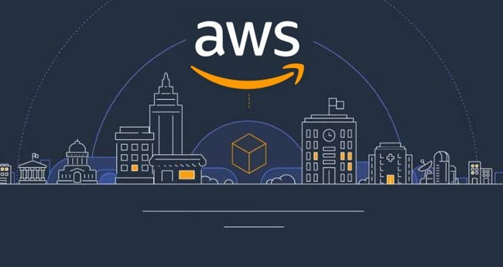
Introduction to AWS

Slide 2
What is AWS?
Definition:
Amazon Web Services (AWS) is a secure cloud services platform offering computing power, database storage, content delivery, and other functionality to help businesses scale and grow.
AWS allows customers to run web and application servers, store data, and perform various tasks using a vast array of services on a global scale.
AWS Global Market Reach
AWS serves millions of active customers, including startups, large enterprises, and leading government agencies.
AWS dominates the cloud market with over 30% market share as of the latest reports.

Slide 3
The Evolution of AWS
Early Beginnings:
AWS was officially launched in 2006, though the development began years earlier as Amazon worked on infrastructure solutions for its e-commerce platform.
Milestones:
2006: AWS launches EC2 and S3, revolutionizing cloud computing.
2011: AWS expands with major services like RDS and CloudFront.
2014: Launch of Lambda introduced serverless computing.
2018: AWS hits $25 billion in annual revenue.
Growth Trajectory:
AWS has consistently expanded its services, infrastructure, and global reach, now offering over 200 fully-featured services.

Slide 4
Global Infrastructure
Regions and Availability Zones:
AWS operates 26 geographic regions globally, each consisting of multiple Availability Zones (AZs). These AZs are distinct data centers that ensure high availability and redundancy.
AWS has over 84 Availability Zones, allowing customers to deploy applications close to their users, reducing latency.
Edge Locations:
Over 400 Edge Locations globally for content delivery and DNS services through AWS CloudFront and Route 53.
These Edge Locations ensure fast content delivery by caching copies of content closer to end-users.

Slide 5
Key Benefits of AWS
Scalability and Flexibility:
AWS provides the ability to scale IT resources up or down as needed, without upfront commitments. Auto-scaling and Elastic Load Balancing automatically distribute incoming application traffic.
Cost-Effectiveness:
With a pay-as-you-go model, AWS helps businesses reduce CapEx. Customers only pay for the resources they use, and there are multiple pricing models (e.g., Reserved Instances, Savings Plans) to optimize costs.

Slide 6
Security:
AWS offers state-of-the-art security features, including encryption, firewalls, and Identity and Access Management (IAM).
AWS complies with major standards and certifications, such as ISO 27001, SOC 1/2/3, PCI DSS, and GDPR.
Innovation:
AWS is at the forefront of technological innovation, offering cutting-edge services in areas like Artificial Intelligence, Machine Learning, Internet of Things (IoT), and Big Data.
Global Customer Base:
AWS’s customer base includes organizations of all sizes, from startups to Fortune 500 companies. Notable customers include Netflix, Airbnb, NASA, and the CIA.

Slide 7
AWS Market Leadership
Market Share:
AWS consistently holds the largest share of the cloud market, with a 32% market share as of 2023, ahead of competitors like Microsoft Azure and Google Cloud.
Revenue Growth:
AWS’s revenue has shown remarkable growth, contributing over $80 billion to Amazon’s overall revenue in 2023.
Innovation and Customer Trust:
AWS’s rapid development and release of new services keep it ahead of the competition, earning trust from businesses for its reliability, innovation, and security.
Competitive Edge:
AWS’s extensive range of services, combined with its global reach, makes it the go-to cloud provider for enterprises needing highly reliable and scalable infrastructure.

Slide 8
Wide Range of Services
Compute:
EC2: Virtual servers in the cloud with a wide variety of instance types.
Lambda: Serverless computing, where you pay only for execution time.
Storage:
S3: Object storage service with industry-leading scalability, data availability, security, and performance.
EBS: Block storage service for use with EC2 instances.
Databases:
RDS: Managed relational databases (MySQL, PostgreSQL, Oracle, SQL Server).
DynamoDB: NoSQL database service for high-performance applications.

Slide 9
Networking:
VPC: Virtual networks for resource isolation.
Route 53: Domain Name System (DNS) web service.
AI/ML:
SageMaker: Build, train, and deploy machine learning models quickly.
Rekognition: Service for image and video analysis.
Security:
IAM: Manage access to AWS services and resources securely.
WAF: Web Application Firewall to protect applications.

Slide 10
Summary of AWS:
AWS is a pioneer and leader in the cloud computing space, offering a broad range of services that cater to virtually any IT need, from basic compute and storage to advanced AI and machine learning solutions.

